Slide 1
Micro Credit Defaulter Project
A comprehensive review

Slide 2
Overview
Introduction
Problem Statement
Problem Analysis
Review of Literature
Data Analysis of the DataSet
Understanding through Visualization
Model Accuracy
Concluding Statement

Slide 3
OVERVIEW
Our client is in Telecom Industry. They are a fixed wireless telecommunications network provider. They have launched various products and have developed its business and organization based on the budget operator model, offering better products at Lower Prices to all value conscious customers through a strategy of disruptive innovation that focuses on the subscriber. They understand the importance of communication and how it affects a person’s life, thus, focusing on providing their services and products to low income families and poor customers that can help them in the need of hour.
They are collaborating with an MFI to provide micro-credit on mobile balances to be paid back in 5 days. They need to understand what are the areas that are relevant for investment and which customers are more likely to be defaulters.

Slide 4
IntroDUCTION
The global microfinance market is growing at a significant CAGR of around 14.8% during the forecast period (2020-2026). Microfinance industry serves the low-income and more overlooked sections of the society. In the recent years, the microfinance industry has reached out a number of small borrowers with significant assistance from the government. Therefore, a modest growth in the global microfinance industry is seen in the last decade. The growth is supported by the continuous establishment of microfinance institutions across the globe. The World Bank estimated that over 7,000 microfinance institutions are operating across the globe, serving nearly 16 million low-income people in emerging economies, such as India and Bangladesh.

Slide 5
Problem statement
Here we are to understand how a Micro finance company can improve the selection of customers for lending the credit. This can help a Microfinance Institute make predictions that could help them in further investment and improvement in selection of customers.

Slide 6
Review of Literature
In order to invest in any field market analysis is essential to understand the dynamics of the market. Here our client being from a Telecom industry has collaborated with a micro finance institution to make the payment process easier for customers belonging to the weaker section of the society. Predicting the defaulter and non-defaulters what the customers prefer gives them a fair idea where to invest and when. The literature attempts to derive useful knowledge from historical data of same market. Machine learning techniques are applied to analyze historical transactions to discover useful models for loan applicants. Moreover, experiments demonstrate that the Decision Tree offers us a competitive approach.

Slide 7
Exploratory Data Analysis
I have imported the dataset which was in excel format.
Printed the head, tail and sample dataset to get a general understanding of the data values.
Performed some of the statistical analysis like dimension of the dataset, data types, info, number of unique values, value counts etc.
Dropped unnecessary columns.
Used LabelEncoder to encode the columns.

Slide 8
Data Pre-processing
Firstly, I have imported the necessary libraries and dataset.
Checked the dimension of the dataset, data types of the features.
Checked the information of the data frame using info() and checked the number of unique values present in the dataset.
I have checked the null values and duplicates but found none in the dataset
Checked the value count of each column.
Visualized each feature using seaborn and matplotlib libraries by plotting count plot, pie plot, distribution plot, box plot and factor plot.
Performed label encoding.
Checked and removed skewness and outliers.
Checked the correlation between the features and visualised it using heatmap.
Described the data using describe().

Slide 9
Data Visualizations
To understand any kind of data it is important to perform Exploratory data analysis (EDA). This is a combination of visualizations and statistical analysis (uni, bi, and multivariate) that helps us to better understand the data we are working with and to gain insight into their relationships. So, let's explore our target variable and how the other features influence it.
We have used bar plots and count plots to visualise the data. ‘

Slide 10
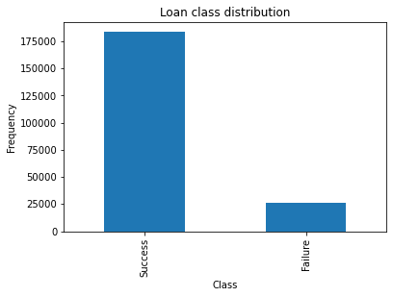
This gives us a details of success and failure. We can see the data is imbalanced.

Slide 11
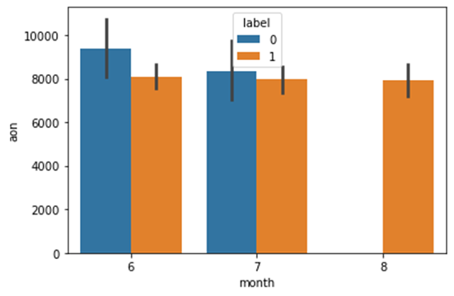
Here is a comparison between ‘aon’ and month. We find there are no defaulter in 8th month i.e. August month of 2016 year.

Slide 12
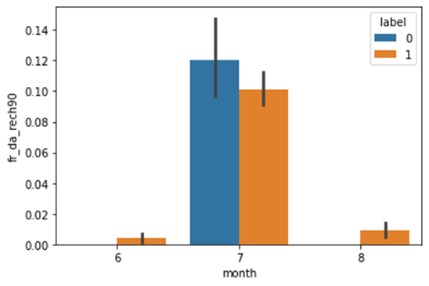
Here we are comparing frequency of data account recharged in last 90 days with the months June, July and August. We can see the frequency is more in month July and least in June. In July month we see that there a huge number of defaulter accounts that had recharged.

Slide 13
From the above it is very much clear that most of the users had taken loan in the month of July and demand decreased in August. The max count of loan is 1 and 2, however, the highest is 3.

Slide 14
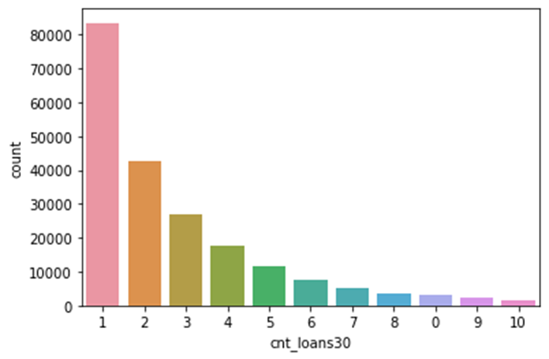
We can see that maximum customers had taken loan for once. This was followed by customers who tool loans twice and thrice respectively. These covers almost 90% of the total data given to us.

Slide 15
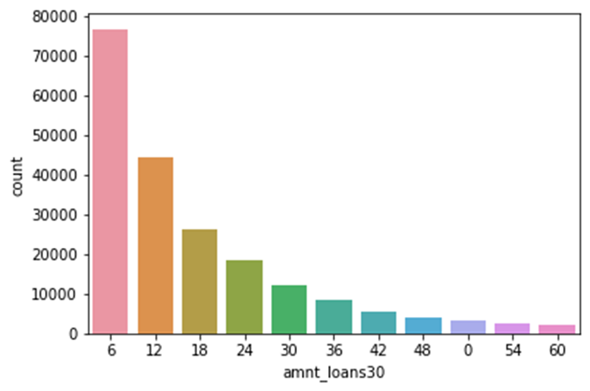
The highest total loan amount that user had taken in the last 30 days is 6, followed by 12,15 and 24.

Slide 16
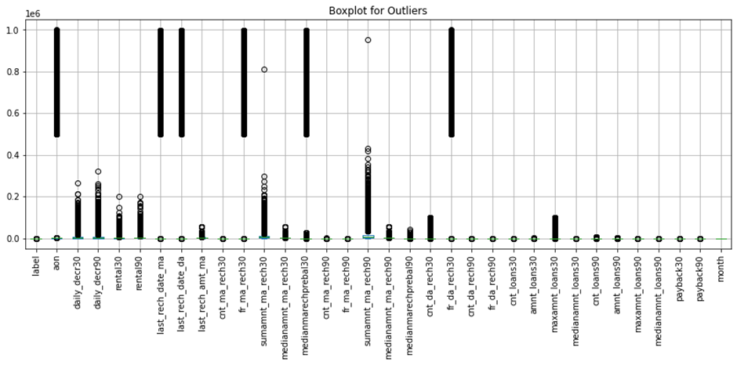
In the above we can see that there are much outliers present in the data which we removed using ‘zscore’ method.

Slide 17
Findings of the Data Analysis
The results that were interpreted from the visualization are as follows:
The data reveals that that there were no defaulters in the month of August.
The frequency of data account recharged in last 90 days is more in month July and least in June.
Most of the users had taken loan in the month of July and demand decreased in August.
Maximum customers had taken loan for once with the amount 6 as highest.

Slide 18
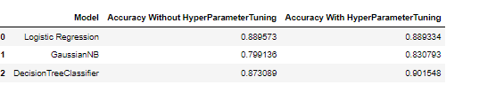
Model accuracy
Here we can see that Decision tree classifier has the highest accuracy. However, if check the other models we can see the results accuracy is almost similar with very little difference, which indicates our chosen model is a best fit.

Slide 19
Conclusions
Through this project I was able to understand the factors that makes micro finance investment decisions better.
The data revealed that customers are prefer short term loans and the loan count increases in the month of July. The loan had been repaid by huge numbers in the month of August, even for the defaulters. The consequent months there was a dip in the loan.
We can see the highest accuracy provided by .
Therefore, we may conclude that good short term offers attracts consumers more than We can see the highest accuracy provided by Decision Tree.
Therefore, we may conclude that good short term offers attracts consumers more than any other. Consumers also opt more for loan amount 6 than any other.
We also found that most of the consumers are non-defaulters and opting for short term loans like 30, 60 or 90 days. Hence, this market seems to be a profitable one for investment.

Slide 20


